Slide 1

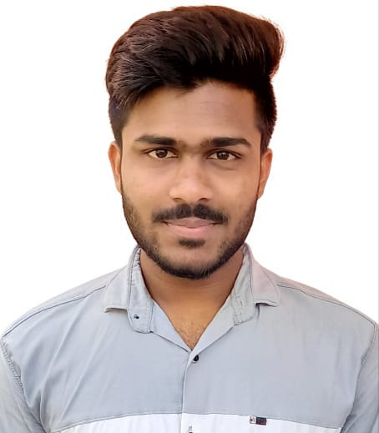



RAKESH V
Education and certificates
Bachelor of Technlogy, Electrical and Electronics Engineering : 2016 - 2020
Skills
Analyst/Software Engineer
Base Location: Bangalore
Email ID: rakesh.c.v@capgemini.com
Mobile No: +91 9972582809
Grade: A4
Spring | Components, Virtual DOM, Routing, Forms & Validation
Database | Postgre SQL
UI Tech | HTML 5 & CSS, JavaScript, Bootsrap 4, Angular JS
Tools | Git & GitHub, Eclipse, STS PostMan,Swagger, Jenkins, Visual Studio Code, Pg Admin 4.
Strengths
Full Stack Developer
Hands on experience on Core java, Postgre SQL, Spring Tool.
Creating Single page Web Application in Angular with Authentication with routing
Hands on experience in developing web pages using HTML5, CSS, Object TypeScript.
Ready to learn new technologies and implement them for the Future Knowledge improvement.
Achievement
Automation Travel Agency
Case study of Automation Travel Agency along with API Gateway, Swagger, responsive UI with HTML5, CSS, Bootstrap and Angular used as User Interface.
Degreed :Successfully complete the degreed training in git, html, CSS, SQL, Angular.
Check out my work on GitHub
Presentation Title | Author | Date © Capgemini 2017. All rights reserved | 1

